Slide 1
Accelerating Python: Offloading to Intel® Xeon Phi™ Co(processors)
Dr.-Ing. Michael Klemm Software and Services Group Intel Corporation
* Some names and brands may be claimed as the property of others.

Slide 2
Legal Disclaimer & Optimization Notice
INFORMATION IN THIS DOCUMENT IS PROVIDED IN CONNECTION WITH INTEL PRODUCTS. NO LICENSE, EXPRESS OR IMPLIED, BY ESTOPPEL OR OTHERWISE, TO ANY INTELLECTUAL PROPERTY RIGHTS IS GRANTED BY THIS DOCUMENT. EXCEPT AS PROVIDED IN INTEL'S TERMS AND CONDITIONS OF SALE FOR SUCH PRODUCTS, INTEL ASSUMES NO LIABILITY WHATSOEVER AND INTEL DISCLAIMS ANY EXPRESS OR IMPLIED WARRANTY, RELATING TO SALE AND/OR USE OF INTEL PRODUCTS INCLUDING LIABILITY OR WARRANTIES RELATING TO FITNESS FOR A PARTICULAR PURPOSE, MERCHANTABILITY, OR INFRINGEMENT OF ANY PATENT, COPYRIGHT OR OTHER INTELLECTUAL PROPERTY RIGHT.
Software and workloads used in performance tests may have been optimized for performance only on Intel microprocessors. Performance tests, such as SYSmark and MobileMark, are measured using specific computer systems, components, software, operations and functions. Any change to any of those factors may cause the results to vary. You should consult other information and performance tests to assist you in fully evaluating your contemplated purchases, including the performance of that product when combined with other products.
Copyright © 2015 Intel Corporation. All rights reserved. Intel, the Intel logo, Xeon, and Xeon Phi are trademarks of Intel Corporation in the U.S. and other countries. *Other names and brands may be claimed as the property of others.
Optimization Notice
Intel’s compilers may or may not optimize to the same degree for non-Intel microprocessors for optimizations that are not unique to Intel microprocessors. These optimizations include SSE2, SSE3, and SSSE3 instruction sets and other optimizations. Intel does not guarantee the availability, functionality, or effectiveness of any optimization on microprocessors not manufactured by Intel. Microprocessor-dependent optimizations in this product are intended for use with Intel microprocessors. Certain optimizations not specific to Intel microarchitecture are reserved for Intel microprocessors. Please refer to the applicable product User and Reference Guides for more information regarding the specific instruction sets covered by this notice. Notice revision #20110804

Slide 3
The pyMIC Offload Infrastructure
Design principles (pyMIC’s 4 “K”s)
Keep usage simple
Keep the API slim
Keep the code fast
Keep control in a programmer’s hand
pyMIC facts
3800 lines of C/C++ code;
1100 lines of Python code for the main API;
libxstream and Intel® LEO for interfacing with MPSS

Slide 4
High-Level Overview
libxstream & Intel® LEO: low-level device interaction
Transfer of shared libraries
Data transfers, kernel invocation
C/C++ extension module
Low-level device management
Interaction with LEO
Low-level API with memcpy-like interface, smart device pointers
High-level API with offload arrays
Library with internal device kernels
High-level Interface [Python]
Low-level Data Management [Python]
pymic_libxstream Engine [Cython]
OffloadArray (kernels) [C]
libxstream & Intel LEO runtime [C/C++]

Slide 5
Example dgemm: The Host Side…
import numpy as np
m, n, k = 4096, 4096, 4096
alpha = 1.0
beta = 0.0
np.random.seed(10)
a = np.random.random(m * k).reshape((m, k))
b = np.random.random(k * n).reshape((k, n))
c = np.empty((m, n))
am = np.matrix(a)
bm = np.matrix(b)
cm = np.matrix(c)
cm = alpha * am * bm + beta * cm
import pymic as mic
import numpy as np
device = mic.devices[0]
stream = device.get_default_stream()
library = device.load_library("libdgemm.so")
m,n,k = 4096,4096,4096
alpha = 1.0
beta = 0.0
np.random.seed(10)
a = np.random.random(m*k).reshape((m, k))
b = np.random.random(k*n).reshape((k, n))
c = np.empty((m, n))
stream.invoke(library.dgemm_kernel, a, b, c, m, n, k, alpha, beta)
stream.sync()

Slide 6
Example dgemm: The Host Side…
import pymic as mic
import numpy as np
device = mic.devices[0]
stream = device.get_default_stream()
library = device.load_library("libdgemm.so")
m,n,k = 4096,4096,4096
alpha = 1.0
beta = 0.0
np.random.seed(10)
a = np.random.random(m*k).reshape((m, k))
b = np.random.random(k*n).reshape((k, n))
c = np.empty((m, n))
stream.invoke(library.dgemm_kernel, a, b, c, m, n, k, alpha, beta)
stream.sync()
Get a device handle
(numbered from 0 to n-1)
Load native code as a shared-object library
Invoke kernel function and pass actual arguments
Copy-in/copy-out semantics for arrays
Copy-in semantics for scalars
Synchronize host and coprocessor

Slide 7
Example dgemm: The Target Side…
Arguments are passed as C/C++ types
All argument passing is done with pointers to actual data
#include <pymic_kernel.h>
#include <mkl.h>
PYMIC_KERNEL
void dgemm_kernel(const double *A, const double *B,
double *C,
const int64_t *m, const int64_t *n,
const int64_t *k,
const double *alpha, const double *beta) {
cblas_dgemm(CblasRowMajor, CblasNoTrans, CblasNoTrans,
*m, *n, *k, *alpha, A, *k, B, *n, *beta, C, *n);
}
Invoke (native) dgemm kernel

Slide 8
High-level Data Structures
OffloadDevice
Interaction with devices
Loading of shared libraries
OffloadStream
Invocation of kernel functions
Buffer management
OffloadArray
numpy.ndarray container
Transfer management
Simple kernels and operators (fill, +, *)

Slide 9
Optimize Offloads with High-level Containers
import pymic as mic
import numpy as np
device = mic.devices[0]
stream = device.get_default_stream()
library = device.load_library("libdgemm.so")
m,n,k = 4096,4096,4096
alpha = 1.0
beta = 0.0
np.random.seed(10)
a = np.random.random(m*k).reshape((m, k))
b = np.random.random(k*n).reshape((k, n))
c = np.zeros((m, n))
offl_a = stream.bind(a)
offl_b = stream.bind(b)
offl_c = stream.bind(c)
stream.invoke(library.dgemm_kernel, offl_a, offl_b, offl_c, m, n, k, alpha, beta)
offl_c.update_host()
stream.sync()
Get a device handle
(numbered from 0 to n-1)
Load native code as a shared-object library
Use bind to create an offload buffer for host data
Invoke kernel function and pass actual arguments
Update host data from the device buffer

Slide 10
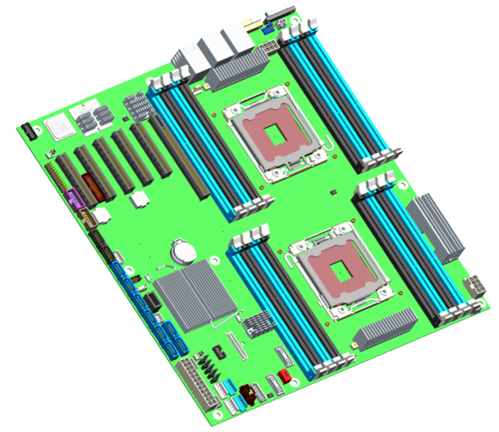
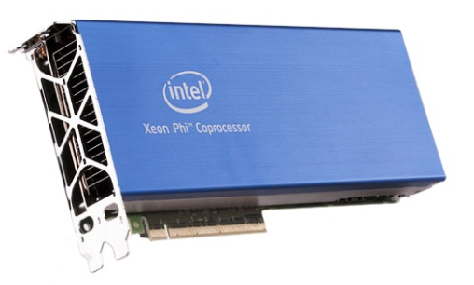
The High-level Offload Protocol
device.load_library()
import pyMIC as mic
import numpy as np
device = mic.devices[0]
libr = device.load_library("libdgemm.so")
stream = device.get_default_stream()
m,n,k = 4096,4096,4096
alpha = 1.0
beta = 0.0
np.random.seed(10)
a = np.random.random(m*k).reshape((m, k))
b = np.random.random(k*n).reshape((k, n))
c = np.zeros((m, n))
offl_a = stream.bind(a)
offl_b = stream.bind(b)
offl_c = stream.bind(c)
stream.invoke(libr.dgemm_kernel, offl_a, offl_b, offl_c, m, n, k, alpha, beta)
offl_c.update_host() stream.sync()
#include <pymic_kernel.h>
#include <mkl.h>
PYMIC_KERNEL
void dgemm_kernel(const double *A,
const double *B,
double *C,
const int64_t *m,
const int64_t *n,
const int64_t *k,
count double *alpha,
const double beta) {
cblas_dgemm(CblasRowMajor,
CblasNoTrans,
CblasNoTrans,
*m, *n, *k,
*alpha, A, *k,
B, *n, *beta, C, *n);
}
0101010100100010101 0101010001010010010
1010100101010101010 0010010011101110001
0101010010101011011
0010101010101010101
0101010100100010101 0101010001010010010
1010100101010101010 0010010011101110001
0101010010101011011
0010101010101010101
host process
a.update_device()
target process
stream.invoke(…)
a.update_host()

Slide 11
Buffer Management: Buffer Creation
class OffloadStream:
def bind(self, array, update_device=True):
if not isinstance(array, numpy.ndarray):
raise ValueError("only numpy.ndarray can be associated "
"with OffloadArray")
# detect the order of storage for 'array'
if array.flags.c_contiguous:
order = "C"
elif array.flags.f_contiguous:
order = "F"
else:
raise ValueError("could not detect storage order")
# construct and return a new OffloadArray
bound = pymic.OffloadArray(array.shape, array.dtype, order, False,
device=self._device, stream=self)
bound.array = array
# allocate the buffer on the device (and update data)
bound._device_ptr = self.allocate_device_memory(bound._nbytes)
if update_device:
bound.update_device()
return bound
class OffloadStream:
def allocate_device_memory(self, nbytes, alignment=64, sticky=False):
device = self._device_id
if nbytes <= 0:
raise ValueError('Cannot allocate negative amount of '
'memory: {0}'.format(nbytes))
device_ptr = _pymic_impl_stream_allocate(device, self._stream_id,
nbytes, alignment)
return SmartPtr(self, device, device_ptr, sticky)
unsigned char *buffer_allocate(int device,
libxstream_stream *stream,
size_t size,
size_t alignment) {
void *memory = NULL;
libxstream_mem_allocate(device, &memory, size, alignment);
return reinterpret_cast<unsigned char *>(memory);
}

Slide 12
Buffer Management: Data Transfer
class OffloadArray:
def update_device(self):
host_ptr = self.array.ctypes.get_data() s = self.stream
s.transfer_host2device(host_ptr,
self._device_ptr,
self._nbytes)
return None
def update_host(self):
host_ptr = self.array.ctypes.get_data()
s = self.stream
s.transfer_device2host(self._device_ptr,
host_ptr,
self._nbytes)
return self
void buffer_copy_to_target(int device,
libxstream_stream *stream,
unsigned char *src,
unsigned char *dst,
size_t size,
size_t offset_host,
size_t offset_device) {
unsigned char *src_offs = src + offset_host;
unsigned char *dst_offs = dst + offset_device;
libxstream_memcpy_h2d(src_offs, dst_offs, size, stream);
}

Slide 13
The Low-level Offload Protocol
import pyMIC as mic
import numpy as np
device = mic.devices[0]
libr = device.load_library("libdgemm.so")
stream = device.get_default_stream()
m,n,k = 4096,4096,4096
alpha = 1.0
beta = 0.0
np.random.seed(10)
a = np.random.random(m*k).reshape((m, k))
b = np.random.random(k*n).reshape((k, n))
c = np.zeros((m, n))
offl_a = stream.bind(a)
offl_b = stream.bind(b)
offl_c = stream.bind(c)
stream.invoke(libr.dgemm_kernel, offl_a, offl_b, offl_c, m, n, k, alpha, beta)
offl_c.update_host() stream.sync()
#include <pymic_kernel.h>
#include <mkl.h>
PYMIC_KERNEL
void dgemm_kernel(const double *A,
const double *B,
double *C,
const int64_t *m,
const int64_t *n,
const int64_t *k,
count double *alpha,
const double beta) {
cblas_dgemm(CblasRowMajor,
CblasNoTrans,
CblasNoTrans,
*m, *n, *k,
*alpha, A, *k,
B, *n, *beta, C, *n);
}
stream.allocate_device_memory(…)
host process
stream.transfer_host2device(…)
target process
stream.transfer_device2host(…)
stream.deallocate_device_memory(…)

Slide 14
Using the Low-level API
import pymic
import numpy
device = pymic.devices[0]
stream = device.get_default_stream()
a = numpy.arange(0.0, 32.0)
b = numpy.empty_like(a)
# determine size of the array in bytes and get pointer
nbytes = a.dtype.itemsize * a.size
ptr_a = a.ctypes.data
ptr_b = b.ctypes.data
# allocate buffer spaces in the target
dev_ptr_1 = stream.allocate_device_memory(nbytes)
dev_ptr_2 = stream.allocate_device_memory(nbytes)
# transfer a into the first buffer and shuffle a bit
stream.transfer_host2device(ptr_a, dev_ptr_1,
nbytes/2, offset_host=0,
offset_device=nbytes/2)
stream.transfer_host2device(ptr_a, dev_ptr_1, nbytes/2,
offset_host=nbytes/2,
offset_device=0)
# do some more shuffling on the target
for i in xrange(0, 4):
stream.transfer_device2device(dev_ptr_1, dev_ptr_2,
nbytes/4,
off_dev_src=i*(nbytes/4),
off_dev_dst=(3-i)*(nbytes/4))
# transfer data back into 'b' array and shuffle even more
for i in xrange(0, 4):
stream.transfer_device2host(dev_ptr_2, ptr_b, nbytes/4,
offset_device=i*(nbytes/4),
offset_host=(3-i)*(nbytes/4))
stream.sync()

Slide 15
Example: Singular Value Decomposition
Treat picture as 2D matrix
Decompose matrix:
M=U×∑×V^{T}
Ignore some singular values
Effectively compresses images

Slide 16
Example: Singular Value Decomposition
Host code
import numpy as np
import pymic as mic
from PIL import Image
def compute_svd(image):
mtx = np.asarray(image.getdata(band=0), float)
mtx.shape = (image.size[1], image.size[0])
mtx = np.matrix(mtx)
return np.linalg.svd(mtx)
def reconstruct_image(U, sigma, V):
reconstructed = U * sigma * V
image = Image.fromarray(reconstructed)
return image
Host code, cont’d
def reconstruct_image_dgemm(U, sigma, V):
offl_tmp = stream.empty((U.shape[0], U.shape[1]), dtype=float, update_host=False)
offl_res = stream.empty((U.shape[0], V.shape[1]), dtype=float, update_host=False)
offl_U, offl_sigma = stream.bind(U), stream.bind(sigma)
offl_V = stream.bind(V)
alpha, beta = 1.0, 0.0
m, k, n = U.shape[0], U.shape[1], sigma.shape[1]
stream.invoke_kernel(library.dgemm_kernel,
offl_U, offl_sigma, offl_tmp,
m, n, k, alpha, beta)
m, k, n = offl_tmp.shape[0], offl_tmp.shape[1], V.shape[1]
stream.invoke_kernel(library.dgemm_kernel,
offl_tmp, offl_V, offl_res,
m, n, k, alpha, beta)
offl_res.update_host()
stream.sync()
image = Image.fromarray(offl_res.array)
return image

Slide 17
Integration with GPAW
GPAW is an open source software package for various quantum mechanical simulations at atomic scale
http://wiki.fysik.dtu.dk/gpaw
Few hundred users all over the world
Implemented as a combination of Python and C
High-level algorithms in Python
Computational kernels in C (or in libraries)
Massively parallelized (with MPI)
Key operation: matrix-matrix multiplication

Slide 18
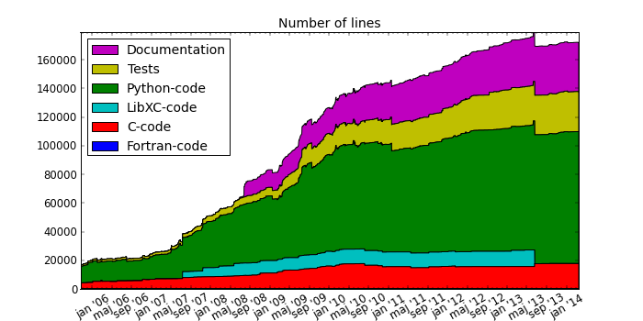
Integration with GPAW
Control the flow of large data (NumPy arrays) in Python level
Offload heavy computations to coprocessor

Slide 19
Integration in GPAW
from gpaw.grid_descriptor
import GridDescriptor
gpts = (64, 64, 64)
nbands = 512
cell = (8.23, 8.23, 8.23)
gd = GridDescriptor(gpts, cell)
psit_nG = gd.zeros(nbands, mic=True)
vt_G = gd.zeros(mic=True)
# Initialize psit_nG and vt_G
htpsit_nG = gd.zeros(nbands, mic=True)
for n in range(nbands):
htpsit_nG[n] = vt_G * psit_nG[n]
H_nn = gd.integrate(psit_nG, htpsit_ng)
import pymic as mic
device = mic.devices[0] stream = device.get_default_stream()
...
def zeros(self, n=(), dtype=float,
mic=False):
array = self._new_array(n, dtype)
if mic:
return stream.bind(array)
else:
return array

Slide 20
Performance: Bandwidth of Data Transfers
Software and workloads used in performance tests may have been optimized for performance only on Intel microprocessors. Performance tests are measured using specific computer systems, components, software, operations, and functions. Any change to any of those factors may cause the results to vary. You should consult other information and performance tests to assist you in fully evaluating your contemplated purchases, including the performance of that product when combined with other products. System configuration: Intel S2600GZ server with two Intel Xeon E5-2697v2 12-core processors at 2.7 GHz (64 GB DDR3 with 1867 MHz), Red Hat Enterprise Linux 6.5 (kernel version 2.6.32-358.6.2) and Intel C600 IOH, one Intel Xeon Phi 7120P coprocessor (C0 stepping, GDDR5 with 3.6 GT/sec, driver v3.3-1, flash image/micro OS 2.1.02.0390), and Intel Composer XE 14.0.3.174. For more complete information visit http://www.intel.com/performance.

Slide 21
Performance: dgemm
Software and workloads used in performance tests may have been optimized for performance only on Intel microprocessors. Performance tests are measured using specific computer systems, components, software, operations, and functions. Any change to any of those factors may cause the results to vary. You should consult other information and performance tests to assist you in fully evaluating your contemplated purchases, including the performance of that product when combined with other products. System configuration: Intel S2600GZ server with two Intel Xeon E5-2697v2 12-core processors at 2.7 GHz (64 GB DDR3 with 1867 MHz), Red Hat Enterprise Linux 6.5 (kernel version 2.6.32-358.6.2) and Intel C600 IOH, one Intel Xeon Phi 7120P coprocessor (C0 stepping, GDDR5 with 3.6 GT/sec, driver v3.3-1, flash image/micro OS 2.1.02.0390), and Intel Composer XE 14.0.3.174. For more complete information visit http://www.intel.com/performance.

Slide 22
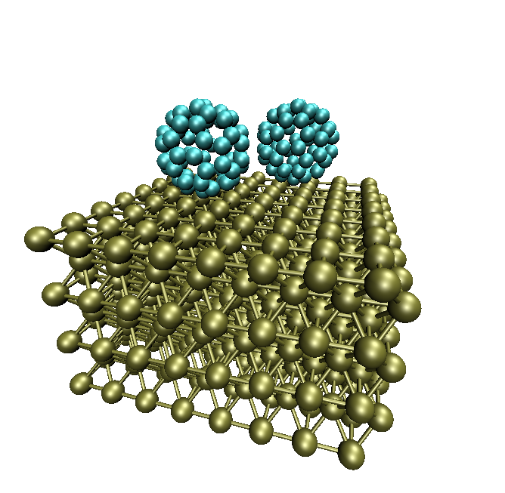
Example Application: GPAW
Open-source software package for quantum mechanical simulations at atomic scale (http://wiki.fysik.dtu.dk/gpaw)
Combination of Python & C
High-level algorithms in Python
Computational kernels in
Massively parallelized (with MPI)
Key operation: dgemm
Software and workloads used in performance tests may have been optimized for performance only on Intel microprocessors. Performance tests are measured using specific computer systems, components, software, operations, and functions. Any change to any of those factors may cause the results to vary. You should consult other information and performance tests to assist you in fully evaluating your contemplated purchases, including the performance of that product when combined with other products. System configuration: Intel S2600GZ server with two Intel Xeon E5-2620v2 6-core processors at 2.1 GHz (64 GB DDR3 with 1600 MHz), Red Had Enterprise Linux 6.5 (kernel version 2.6.32-358.6.2) and two Intel Xeon Phi 7120P coprocessor (C0 stepping, GDDR5 with 3.6 GT/sec, MPSS v3.3.30726), and Intel Composer XE 14.0.3.174. For more complete information visit http://www.intel.com/performance.

Slide 23
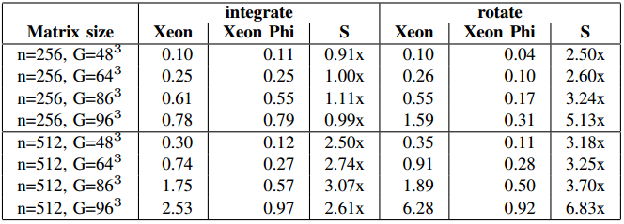
Performance: GPAW integrate and rotate
Software and workloads used in performance tests may have been optimized for performance only on Intel microprocessors. Performance tests are measured using specific computer systems, components, software, operations, and functions. Any change to any of those factors may cause the results to vary. You should consult other information and performance tests to assist you in fully evaluating your contemplated purchases, including the performance of that product when combined with other products. System configuration: Intel S2600GZ server with two Intel Xeon E5-2697v2 12-core processors at 2.7 GHz (64 GB DDR3 with 1867 MHz), Red Had Enterprise Linux 6.5 (kernel version 2.6.32-358.6.2) and Intel C600 IOH, one Intel Xeon Phi 7120P coprocessor (C0 stepping, GDDR5 with 3.6 GT/sec, driver v3.3-1, flash image/micro OS 2.1.02.0390), and Intel Composer XE 14.0.3.174. For more complete information visit http://www.intel.com/performance.

Slide 24
Summary & Future Work
pyMIC
A slim, easy-to-use offload interface for Python
Native kernels on the target devices
Almost negligible extra overhead for Python integration
Future versions will likely bring:
Offloading of full {C|P}ython code
Download pyMIC at https://github.com/01org/pyMIC.
Mailinglist at https://lists.01.org/mailman/listinfo/pymic

